Slide 1
async_hooks
for future Node.js sampling & monitoring
https://github.com/aojiaotage

Slide 2
async_hooks 101
01
03
New in Node.js 8.0
Native support for hooks of async contexts.
02
Still experimental June 2018

Slide 3
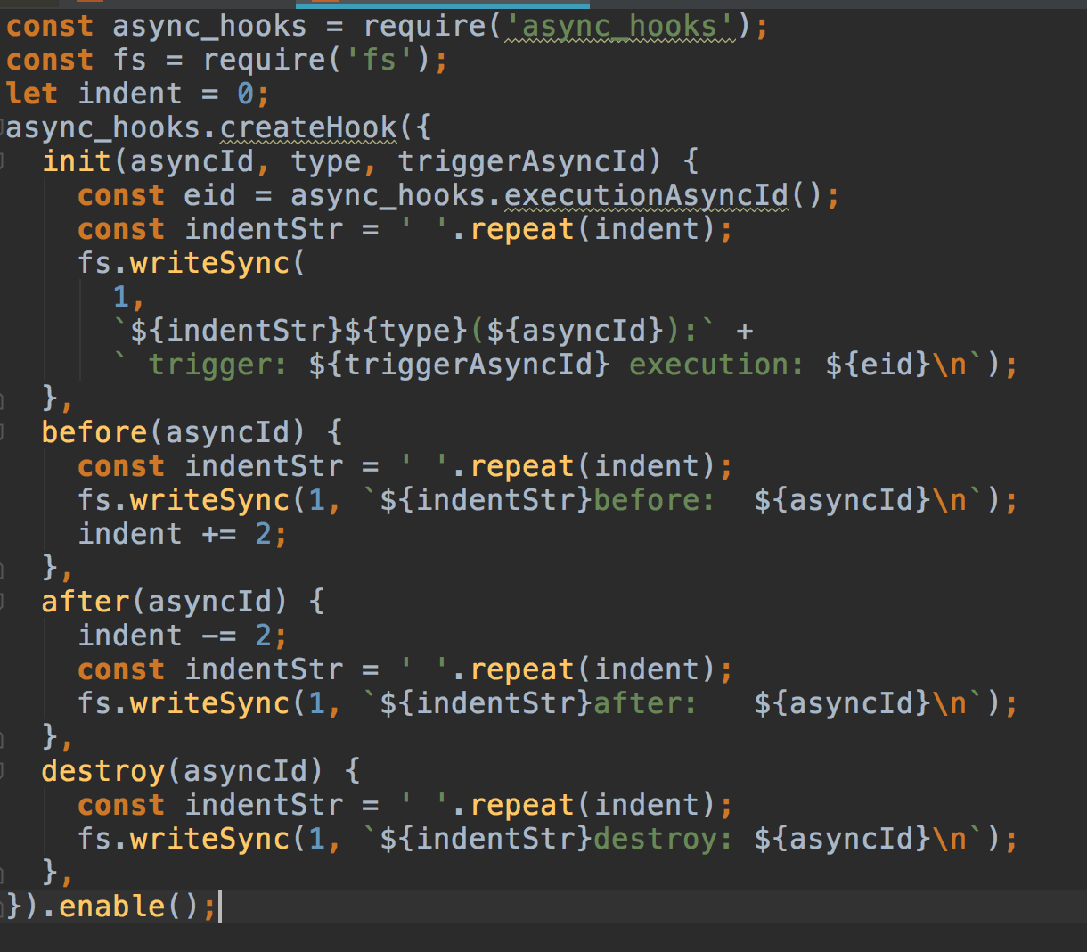
t3/4 of its api.
3/4 of its api.

Slide 4
t3/4 of its api.
Let’s see how it works on an auto-gen express demo
Trust me

Slide 5
t3/4 of its api.
How could code like this help?
Trust me

Slide 6
Part one
Monitoring…
Trust me

Slide 7

t3/4 of its api.
Find out potential infinity loops
1.Heart-beats on connections to databases.
2.IPC data sync, which kue actually dose.
3.File access which might be unecessary

Slide 8
t3/4 of its api.
Evaluate how heavy your app is under certain load
1. Does you app get too busy even on zero load?
2.Or maybe too many hangup timers?
3.Performance down on high load?

Slide 9
t3/4 of its api.
Best at catching hanging timers
By simply register timers on init() and unregister them on destory(), you could check hanging timers any time you want.
It works great if you already found times taking too much memory or causing a memory leak through v8 dump.

Slide 10
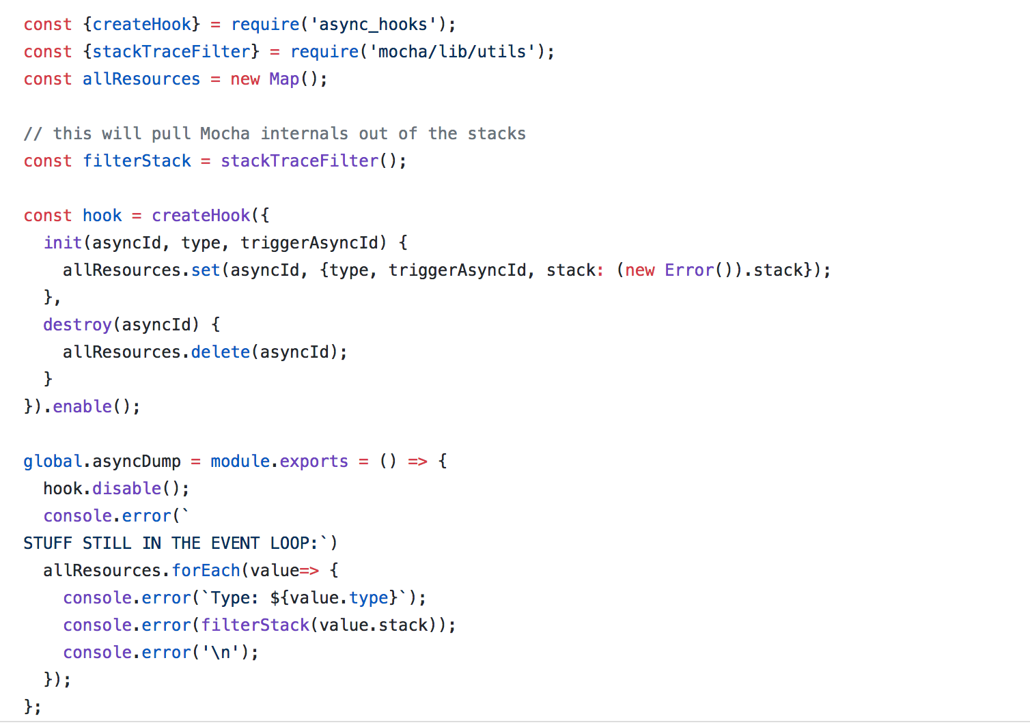
t3/4 of its api.
Like mocha did…

Slide 11
Part two
Sampling…
Trust me

Slide 12
tt3/4 of its api.
Performance Concerns
1.Is it slow? Yes, base on what you write inside hook functions.
2.Can I enable it in production? Yes, but better not enable all the time.
3.Maybe sampling? Yes, might be best practice now if you have to use it in production env.

Slide 13
tt3/4 of its api.
Possible way to sampling.
1.Use one cluster on web apps.
2.Auto triggered and shutdown for a small amount of time.
3.Log only when necessary.
4.Check for certain resource types.

Slide 14
In short
2.Still experimental.
1.Great for sampling/monitoring especially on async contexts.
02
01
03
3.Careful in production.
04
4.Chance of commits to Node.js

Slide 15
THANKS
LURENLAOYANG
Thank you for participating Node Party Shanghai 2018.

